Slide 1
Multi-Qubit Gate with Neutral Atoms
Saffman Group Talk
Xiaoyu Jiang
2021/07/30

Slide 2
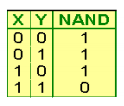
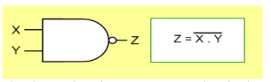
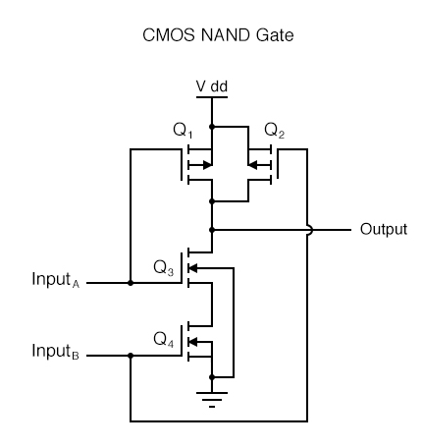
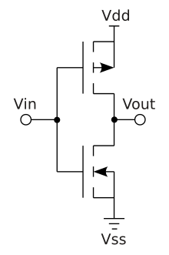
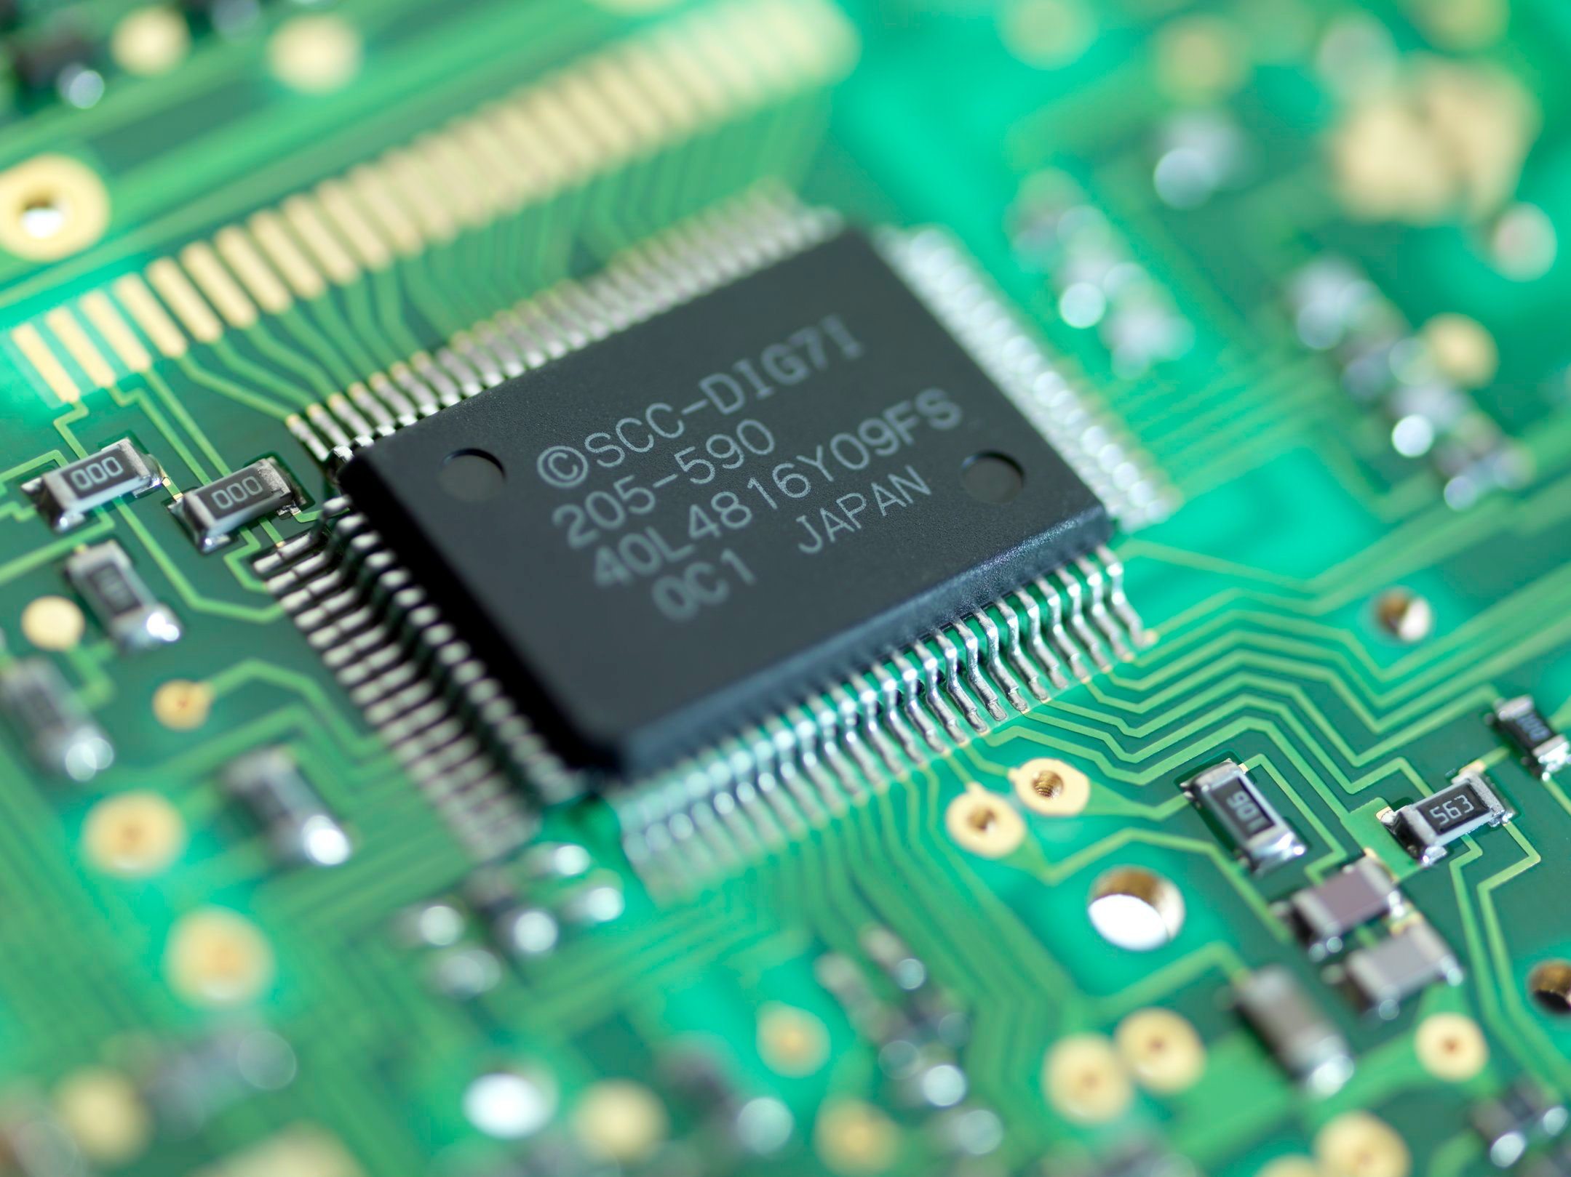
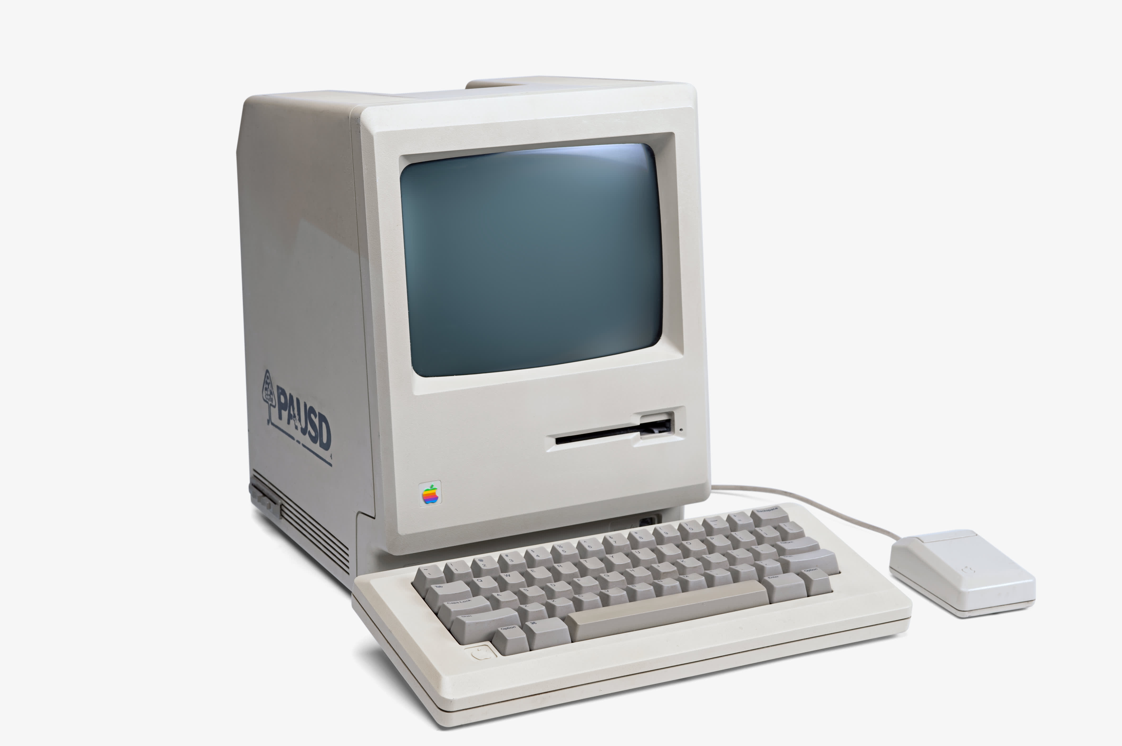
Classical computation: NAND gate is universal.
A CMOS transistor
CMOS: complementary-symmetry metal–oxide–semiconductor
Integrated Circuit
Computer
Quantum Computation: single qubit and CNOT gates are universal.
Large number of qubits
High fidelity universal gate set

Slide 3
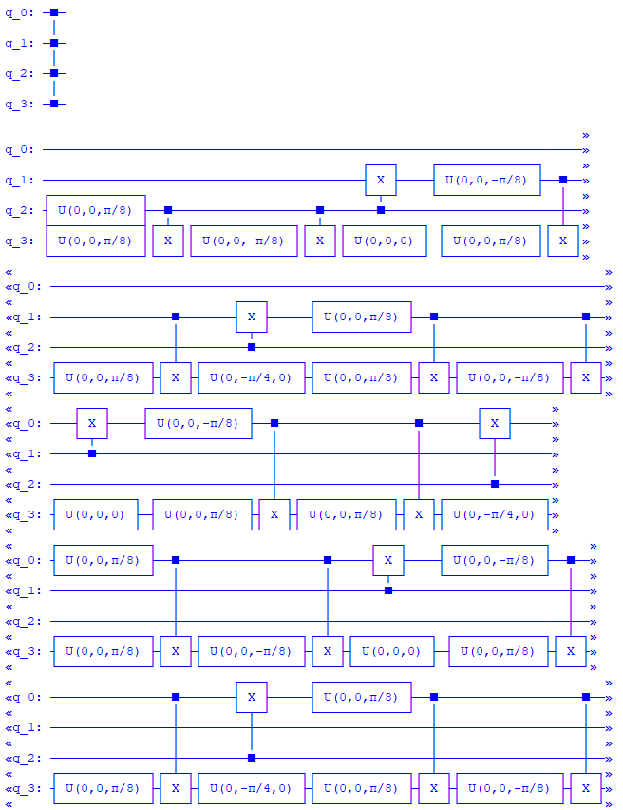
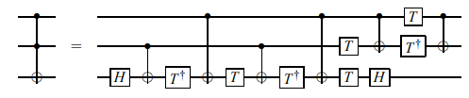
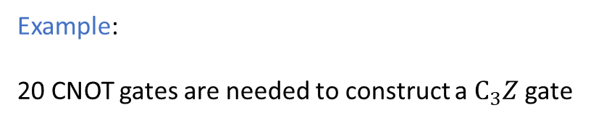
Decomposing a multi-qubit gate into the universal set is not always efficient.
Example:
6 CNOT gates are needed to construct a Toffoli gate
Example:
20 CNOT gates are needed to construct a $C_{3}Z$gate
Cost: error, time

Slide 4
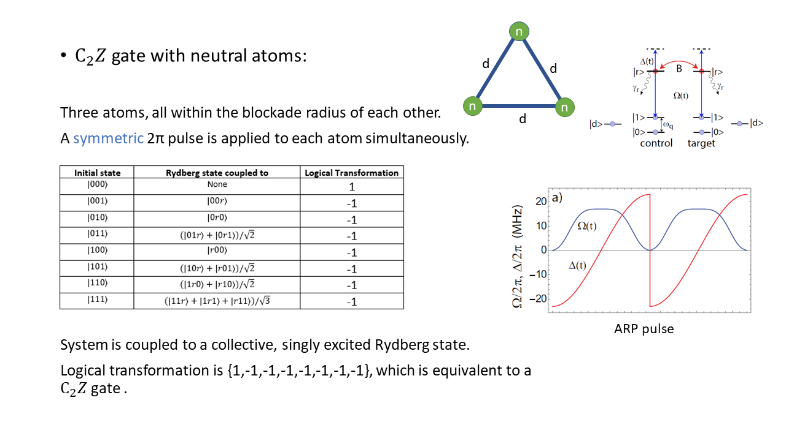

Slide 5
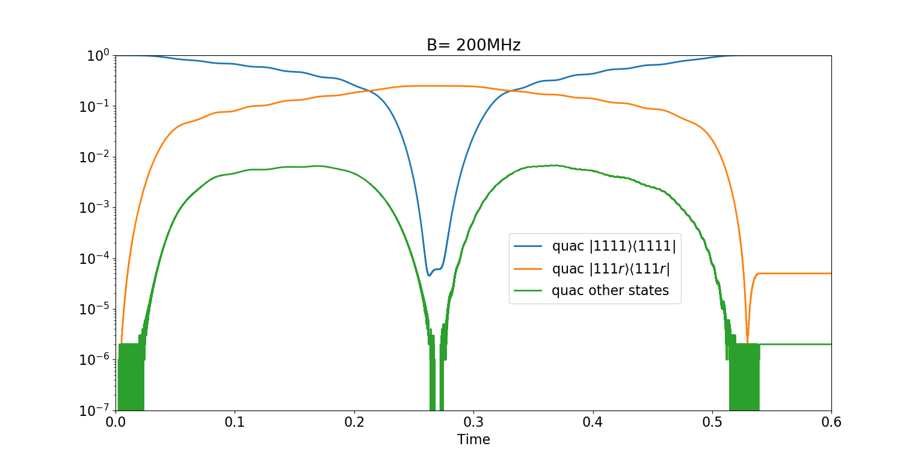

Slide 6
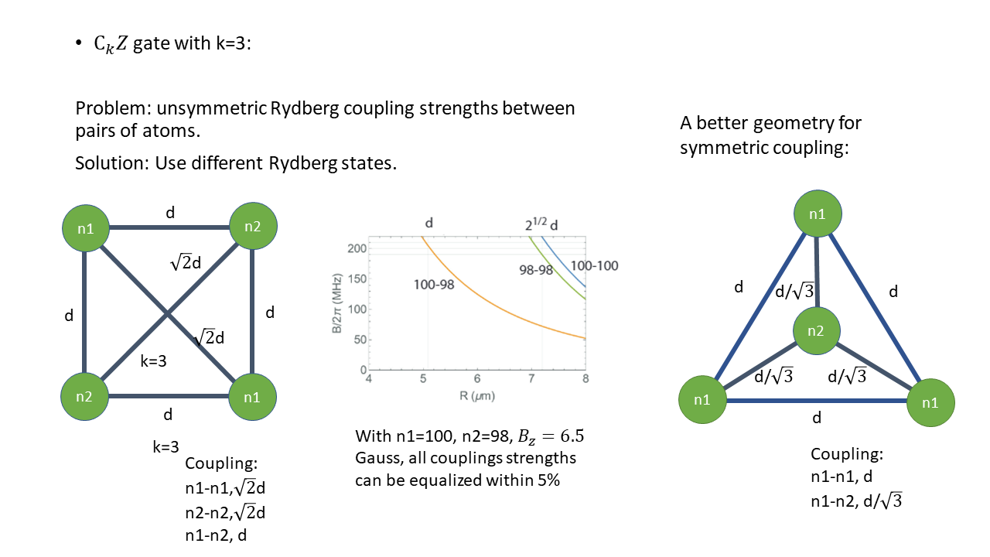

Slide 7
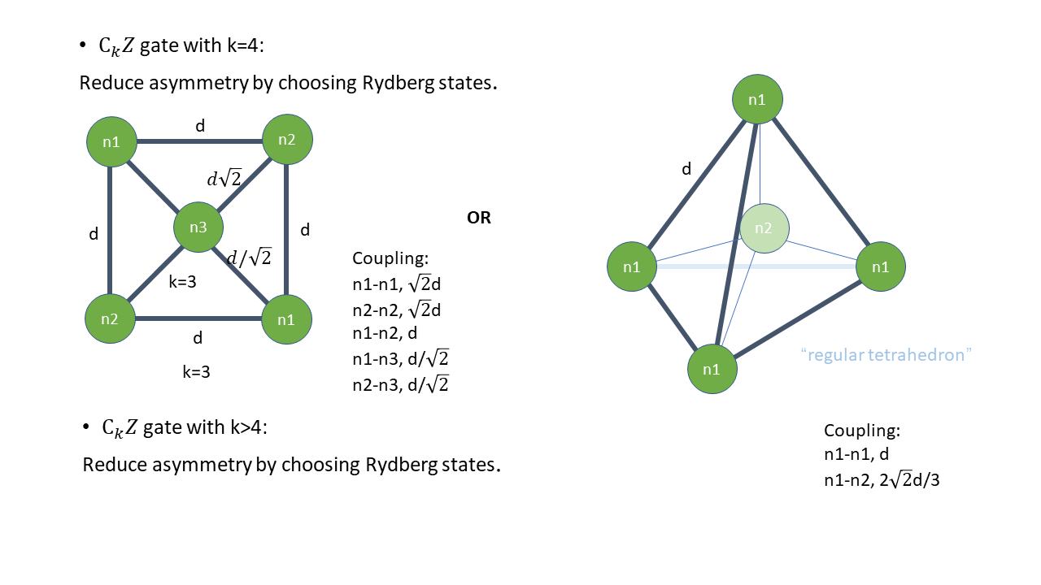

Slide 8
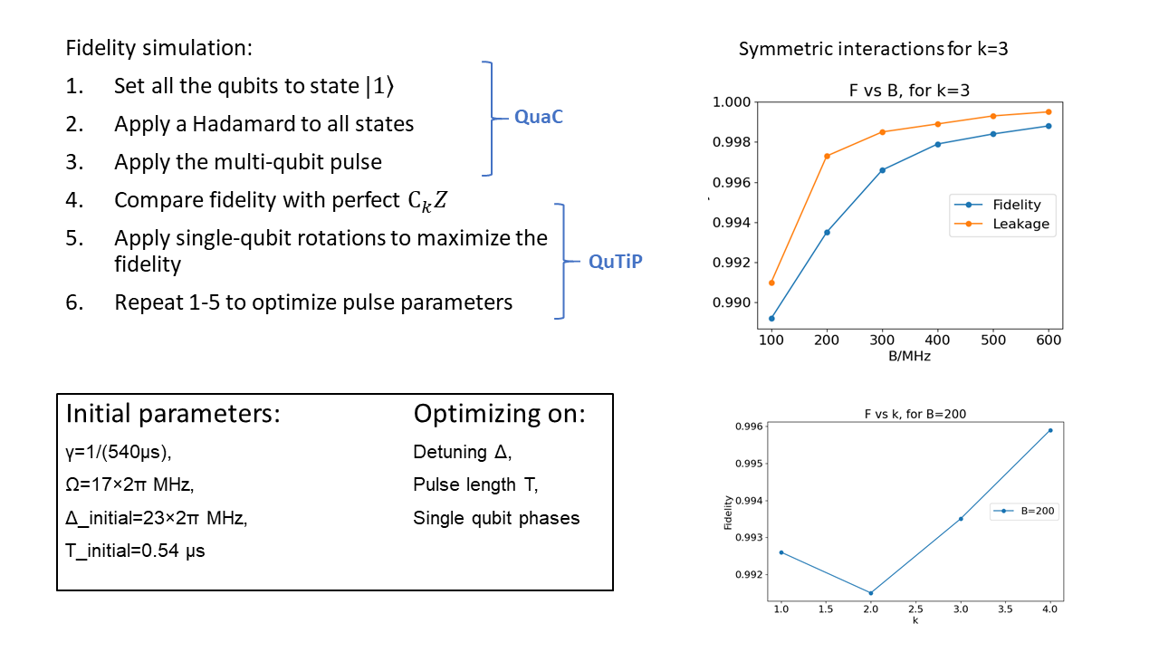

Slide 9
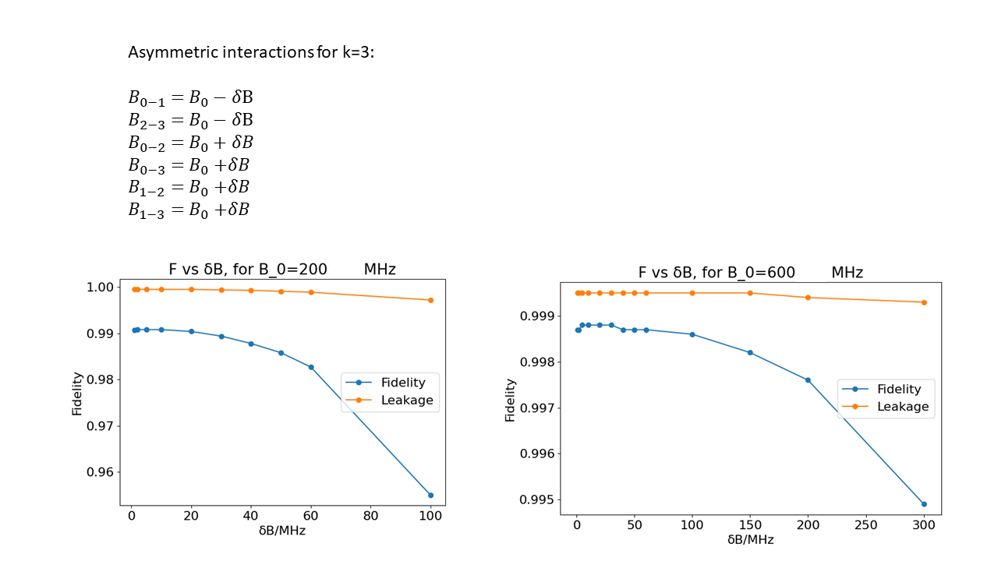

Slide 10
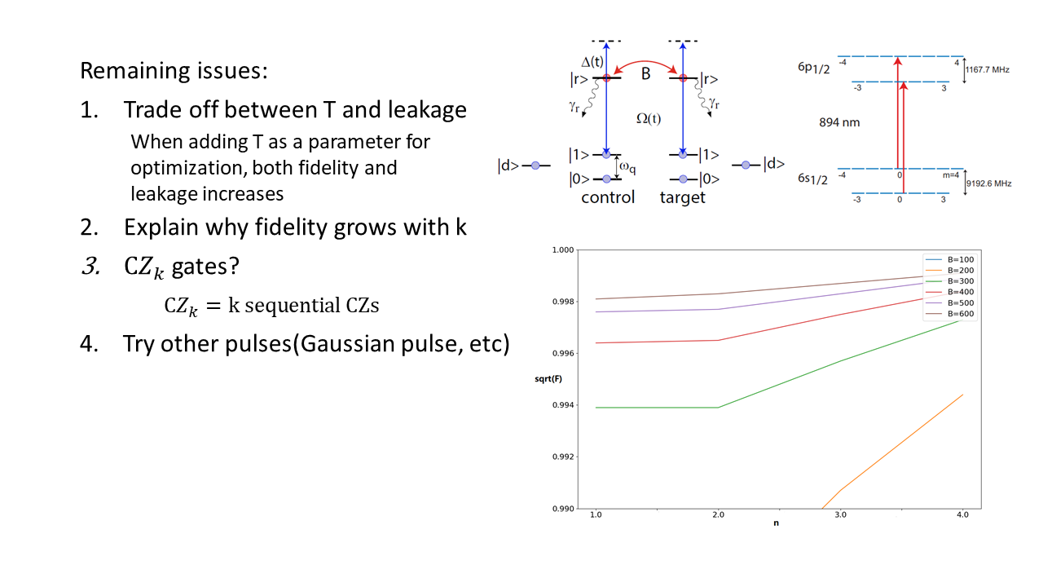

Slide 11


